Slide 1

Events overview: 26 June 2024

Slide 2
Delivering summer well being festivals
Placed based organised
Free activities, learning and fun
Everyone invited
Community venues, green spaces
Wellbeing groups and services
Taster sessions – sport, art to dance
Range of NHS Health checks
Bring a picnic + healthy food
Meet new people, have a good time
2 |

Slide 3

What we’re planning to do:
We have eight Summer Wellbeing Festivals happening over the summer
Between August-September 2024
Delivery in partnership with hub network & local organisations
Small funding pot for each event
Promotional support and my team’s support
Potential to showcase and celebrate the summer festivities
at our AGM in September
3 |
Notes:
Also promoting any other event that fits the well being theme over the timeframe within the campaign

Slide 4
Theme for the event: 5 themes of wellbeing
We’d like to theme our summer well being festivals around 5 ways of well being to help our public find out what support, activities are available to help their well being, focusing on:
Get checked – NHS health checks, cancer screenings, vaccinations
Eat well – healthier eating, portion control
Move more – tips to help you move more
Try new things – learn new skills, take up a new hobby, sport or join a group
Be kind– volunteering, blood donation, get out into nature, meet with friends, , sign up for organ donation
Those exhibiting and your event need to be around these themes.
Everything should be free or affordable (if food is sold)
Smoke and alcohol free
4 |
Notes:
Also promoting any other event that fits the well being theme over the timeframe within the campaign

Slide 5
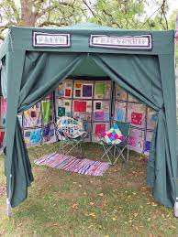

Festival ‘buddy’ scheme and meet a friend tent
We have lots of fantastic volunteers, staff and supporters in our local communities who could support people visiting our festivals to find out more.‘Meet a friend’ tent and ‘happy to chat’ bench
The aim could be a ‘well being’ buddy role that meets/greets people and supports them to get the
most out of the event
We can combine the buddy scheme with a is
‘personalised’ prevention conversations and using
our new well being booklet and action/tracker
5 |
Notes:
Also promoting any other event that fits the well being theme over the timeframe within the campaign

Slide 6
NHS health check offer
Our NHS health check teams will be attending all events to provide:
blood pressure check
cholesterol check
weight//BMI
health and vaccinations advice
Qrisk score (risk of developing cardiovascular problems such heart attack, stroke, diabetes, kidney problems over the next 10 years)
smoking cessation.
6 |

Slide 7
Healthy Cornwall Offer at festivals
Healthy Cornwall have kindly agreed to provide countywide for the Summer Festivals as below;
Early Years Games (low level balance beams)
Pop up tennis
Pop up football
Target games
Co monitoring
Display boards with signposting and health campaigns (national and local)
7 |

Slide 8
Dates for the summer wellbeing festivals
Location | Date | Time
Redruth Rugby Club and CN4C, The Elms | Saturday 3 August | 10am-3pm
Park House Centre Bude | Saturday 3 August | 11am-3pm
Humphry Davy School & Trelya, Penzance | Friday 9 August | 2-7pm
Poltair Park and CN4C The One and All Bank, St Austell | Saturday 17 August | 10am-3pm
Town Hall, Launceston | Saturday 17 August | 11am-3pm
Basset Centre, Camborne | Saturday 14 September 2024 | 9.30am-12.30pm
Hayle Recreation Ground, Hayle | Saturday 14 September 2024 | 2pm -5pm
Newquay Orchard | Saturday 21 September | 10am-3pm
8 |
Notes:
Ask Community hub attending to confirm who they are/location of hubs

Slide 9
Communications toolkit: 26 June 2024

Slide 10
Overview
NHS Cornwall and Isles of Scilly working together with local partners and organisations are running a health and wellbeing campaign called ‘Healthier Together’ providing advice and information about how you can make small changes in your daily life that will have a big impact on your future health and wellbeing.
As part of this campaign, there are 8 free Summer Wellbeing Festivals are happening over the summer.
This is the communications toolkit for the summer wellbeing festival which provides a variety of communications materials which includes:
Poster for the main event
Poster templates – in word and power point, you can also resize for printing as A5 leaflets
Text for you to use on websites or in newsletters/other comms as required
Website pages have been set up and will be updated here: https://www.healthycornwall.org.uk/HealthierTogether/
Please support the promotion of our Summer Wellbeing Festivals using this toolkit, and if you have any questions, please get in touch with the team on: ciosicb.engagement@nhs.net
10 |
Notes:
Ask Community hub attending to confirm who they are/location of hubs

Slide 11
Healthier Together – summer wellbeing festival
(For use in ebulletin or web text)
NHS Cornwall and Isles of Scilly working together with lots of local organisations are running a health and wellbeing campaign called ‘Healthier Together’ providing advice and information about how you can make small changes in your daily life that will have a big impact on your future health and wellbeing.
Come along to our free Summer Wellbeing festivals
As part of our campaign, we’re running free Summer Wellbeing Festivals over the summer, so why not attend one happening close to you:
Redruth Rugby Club and Elms
Saturday 3 August
Park House Centre, Bude
Saturday 3 August
Humphrey Davy School & Trelya, Penzance
Friday 9 August
Poltair Park, St Austell
Saturday 17 August
Town Hall, Launceston
Saturday 17 August
Basset Centre, Camborne
Saturday 14 September 2024
Hayle Recreation Ground, Hayle
Saturday 14 September 2024
Newquay Orchard
Saturday 21 September
We look forward to seeing you there!
To find out more about the events visit: https://www.healthycornwall.org.uk/HealthierTogether/
11 |

Slide 12


Logos for the festival

Slide 13
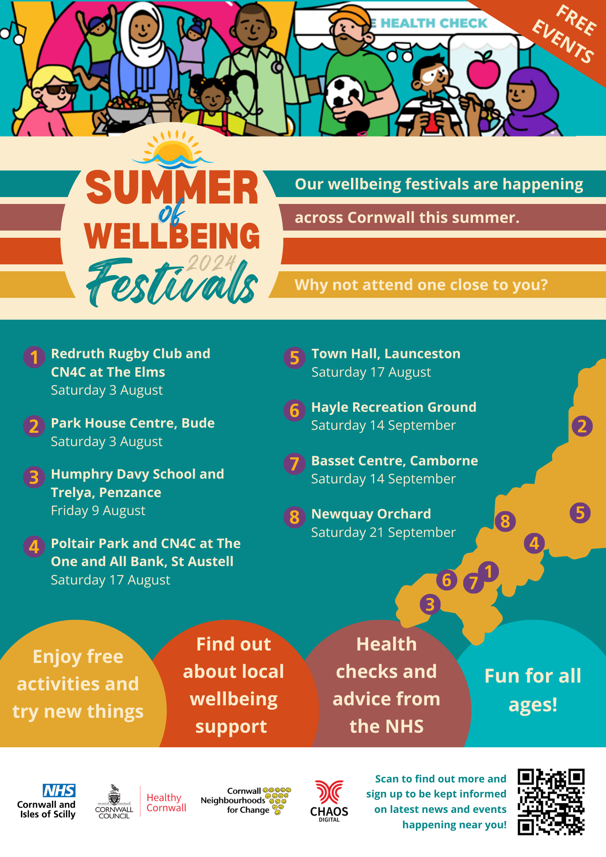
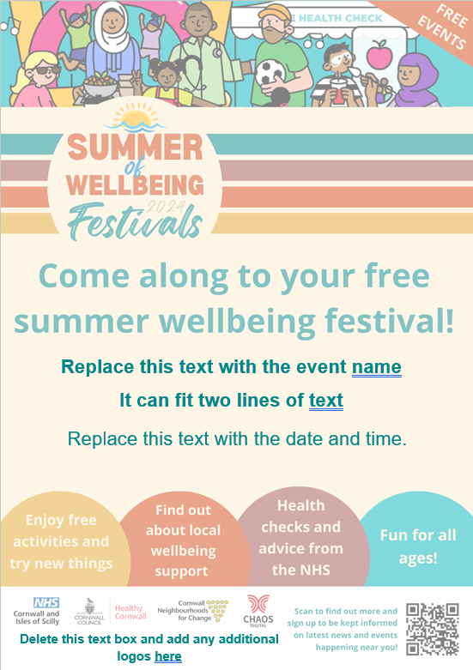
Summer Festival comms toolkit – see zip folder at end
Poster and leaflet
Main A4 poster advertising all events with a map of locations.
Self fill templates
Event-specific poster with area to write about the individual event.
Highlighted areas can be customised (Word and Powerpoint versions included)
For A5 flyer versions, print using an A5 page size and “fit to page” option.

Slide 14


Socials media graphics
This includes graphic and animated graphic (Click below to play)
14 |
Notes:
Also promoting any other event that fits the wellbeing theme over the timeframe within the campaign

Slide 15
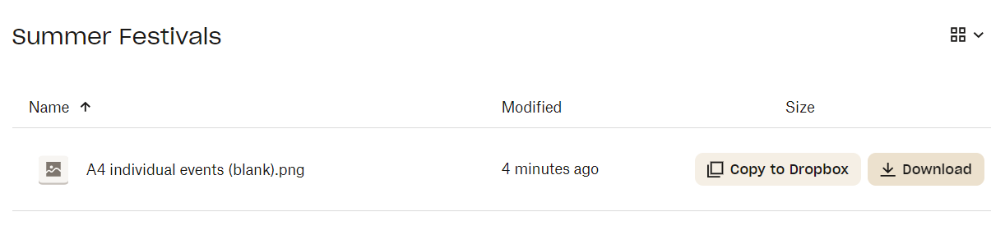
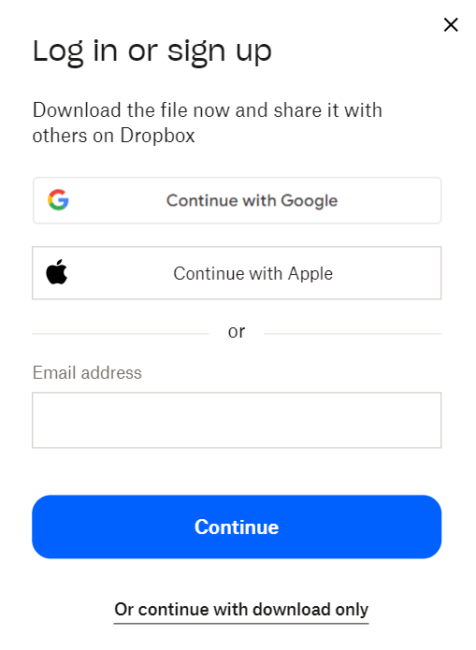
Downloads all the comms toolkit elements
Click here to download the toolkit resources
Hover over the item and choose “download” on the right-hand side
Choose “Or continue with download only” at the bottom
15 |

